Slide 1

DD vs TAC Laminate Stacking Sequence Comparison
+30º
+60º
-60º
-30º
-30º
-60º
+60º
+30º
+20º
+35º
+55º
+70º
-70º
-55º
-35º
-20º
DD
TAC

Slide 2
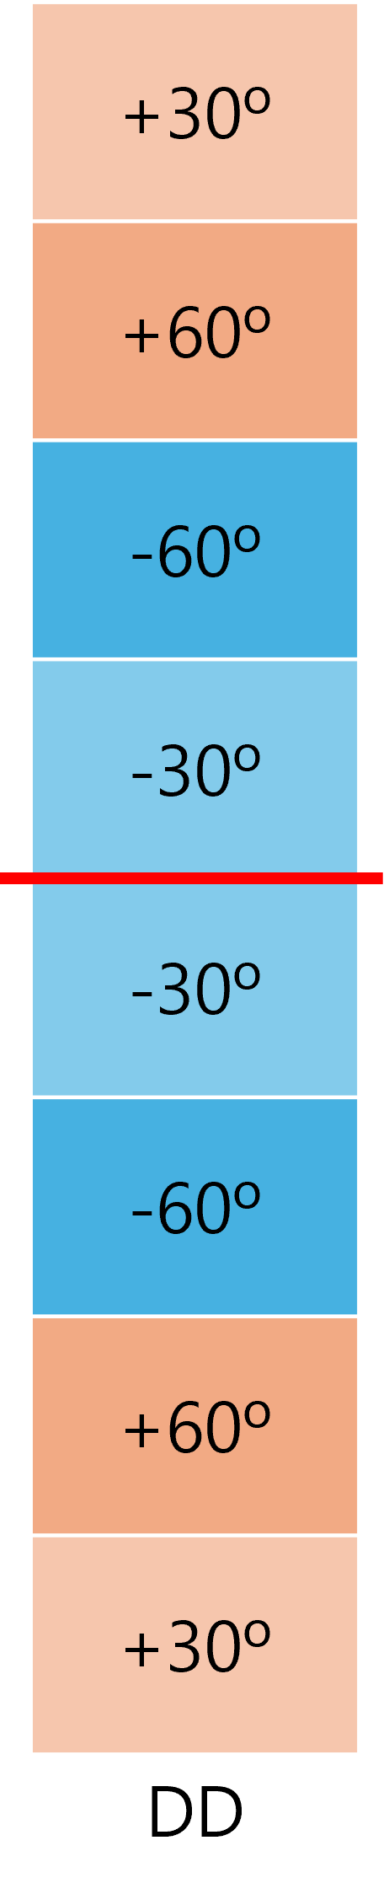
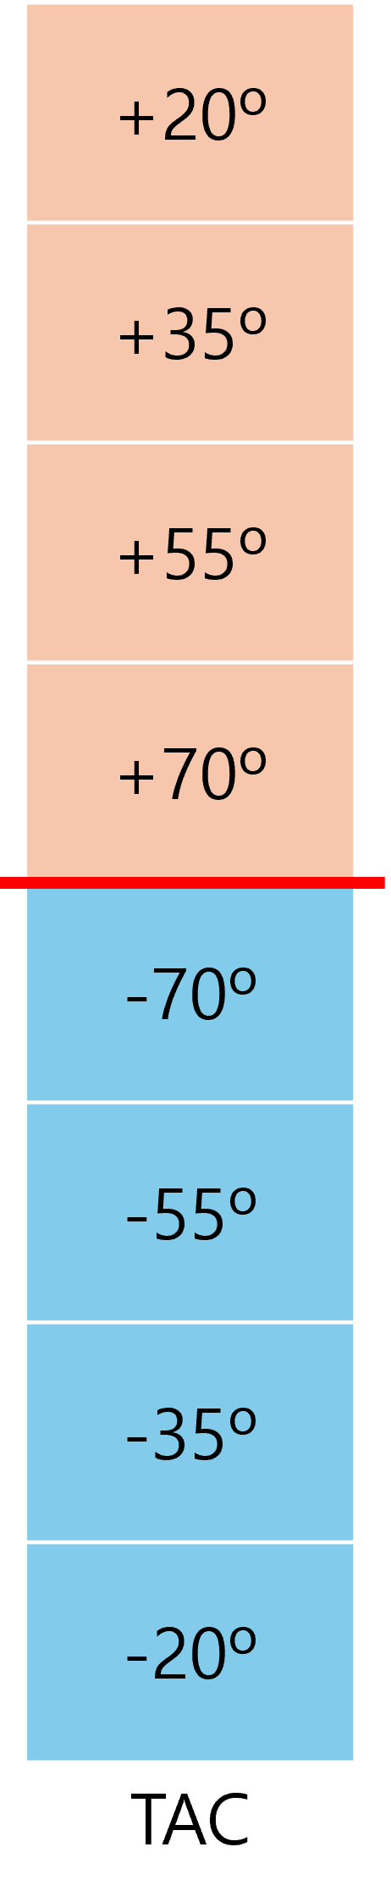
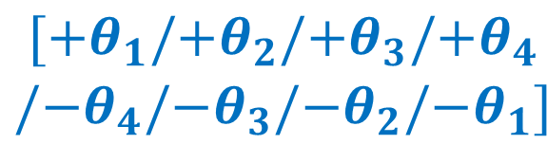
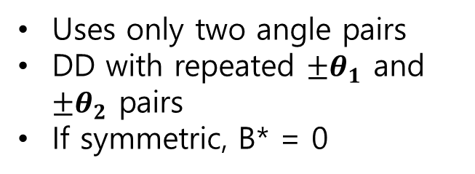

Basic difference between DD and TAC
Both use +θ and −θ pairs, but the design freedom is different
$${[{+θ}_{1}/{+θ}_{2}{/−θ}_{2}/{−θ}_{1}]}_{s}$$
$$\begin{aligned}[{+θ}_{1}/{+θ}_{2}{/+θ}_{3}/{+θ}_{4} \\ {/−θ}_{4}/{−θ}_{3}{/−θ}_{2}/{−θ}_{1}]\end{aligned}$$
Uses only two angle pairs
DD with repeated ${±θ}_{1}$ and ${±θ}_{2}$ pairs
If symmetric, B* = 0
The number of angle pairs is not limited to two
Coupling can be tailored through an antisymmetric relation
B16 and B25 can intentionally become nonzero

Slide 3
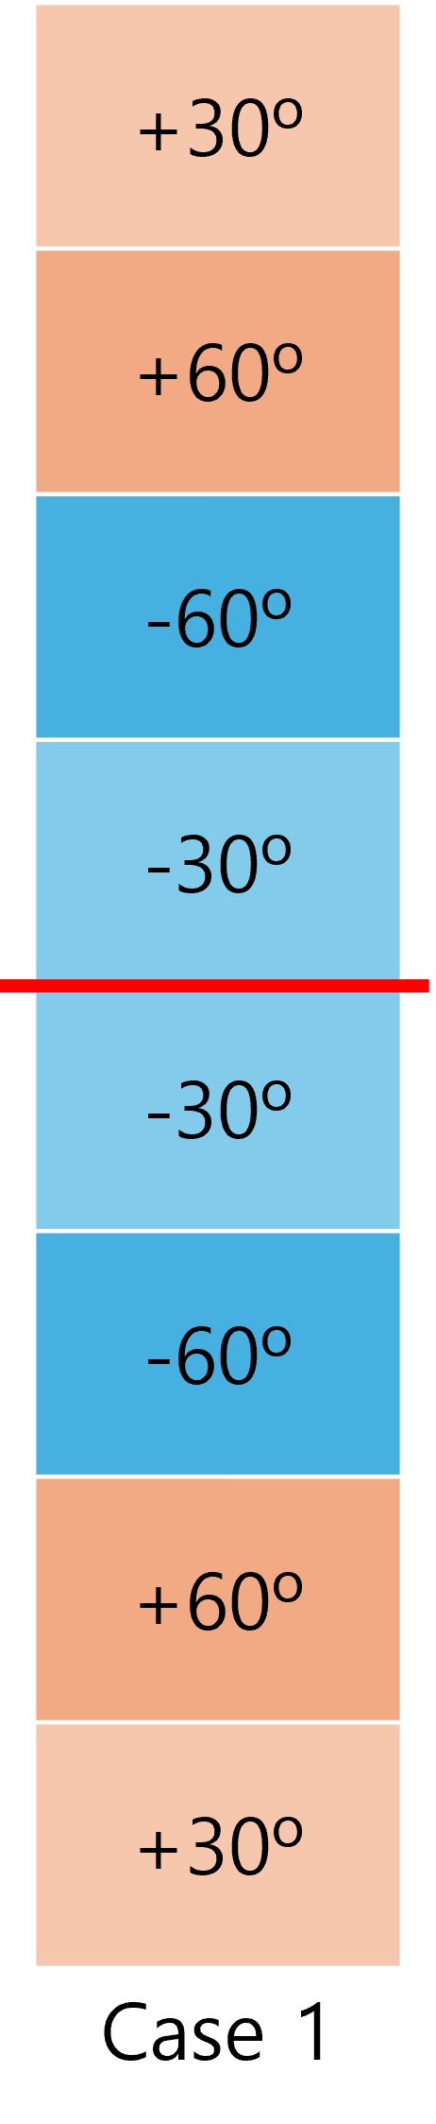
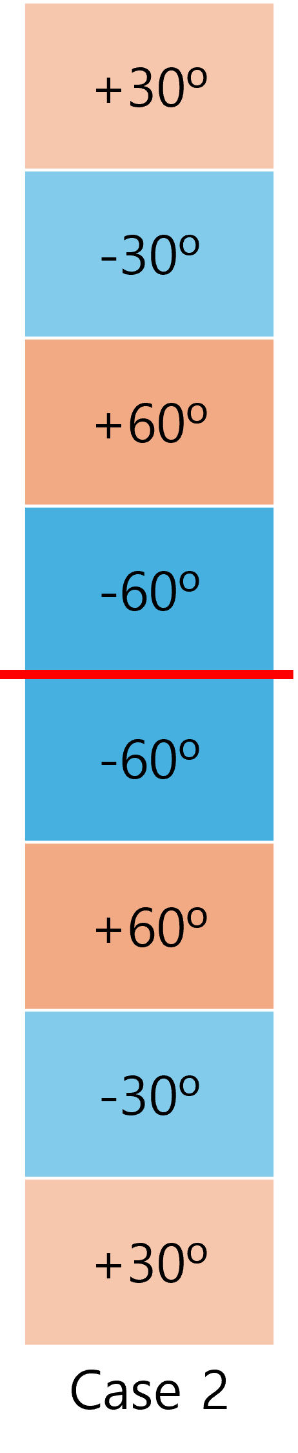
Key point from the DD cases
Case 1 and Case 2 contain the same angle counts, but D* changes because the stacking order is different
Case 1
A11/A22 = 1.00
D11/D22 = 1.28
B16, B26 = 0
A* is the same, but D* is different. This means buckling and bending depend not only on the number of plies at each angle, but also on where those plies are placed through the thickness.
Case 2
A11/A22 = 1.00
D11/D22 = 2.96
B16, B26 = 0
Conclusion: Case 1 is the more balanced DD baseline. Case 2 has a larger D11, but a much lower D22, so it is more directionally biased.

Slide 4
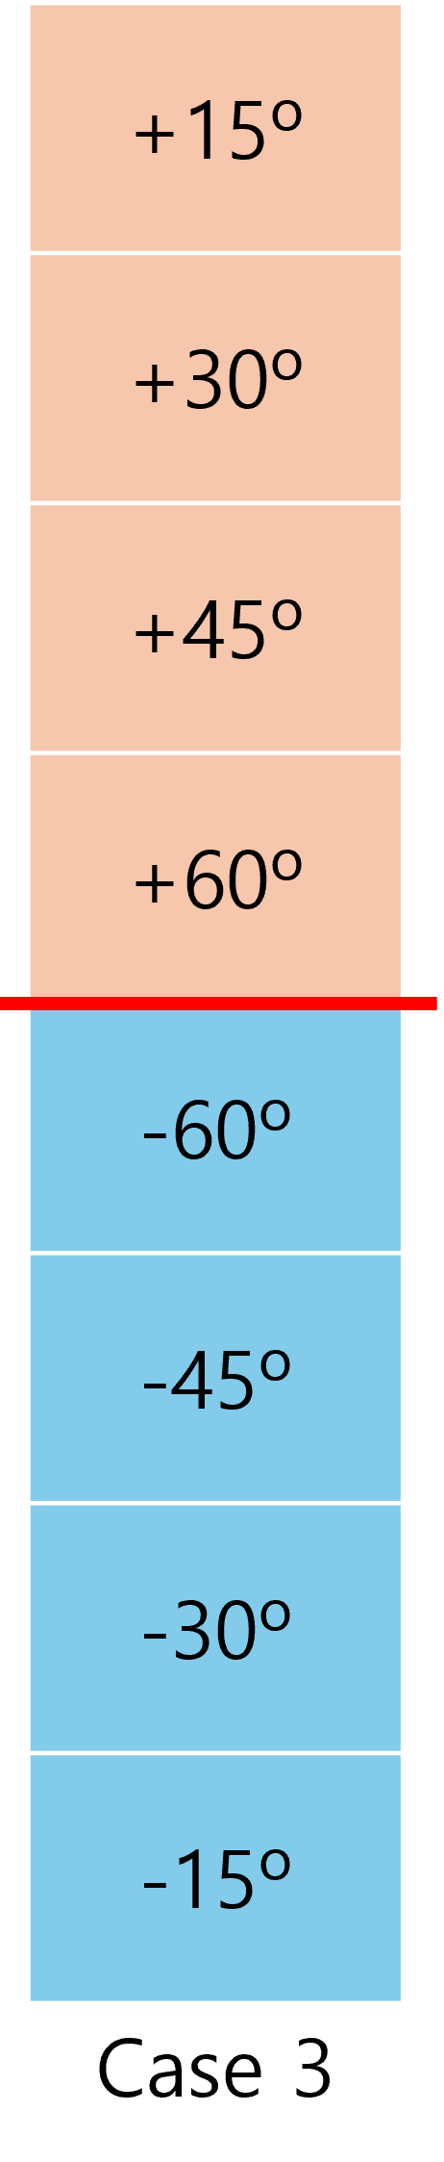
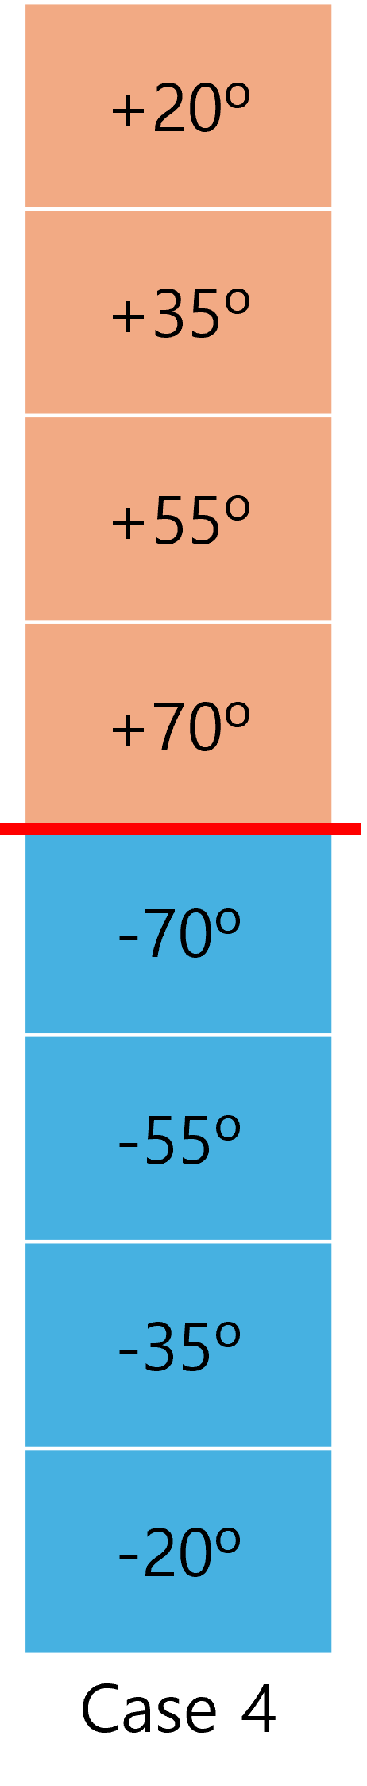
Key point from the TAC cases (8-ply)
Case 3 and Case 4 contain the same angle counts, but D* changes because the stacking order is different
Case 3
A11/A22 = 1.76
D11/D22 = 6.27
B16, B26 = -2.6, -1.13
Case 3 gives the higher D11*, so it is stronger in the x-bending direction. Case 4 gives A11* = A22*, so its in-plane stiffness is more balanced. Both have nonzero B16* and B26*, which is the key TAC coupling feature.
Case 4
A11/A22 = 1.00
D11/D22 = 3.97
B16, B26 = -2.57, -1.46
Conclusion: Case 4 is the better 8-py TAC representative for the main comparison because it is more balanced. Case 3 should be described as a specialized high-D11* TAC case

Slide 5
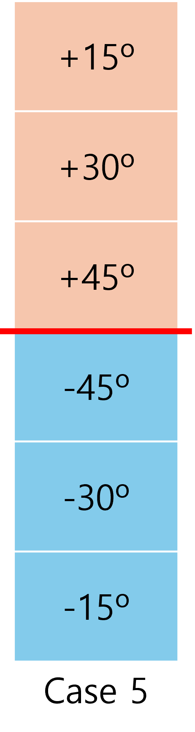
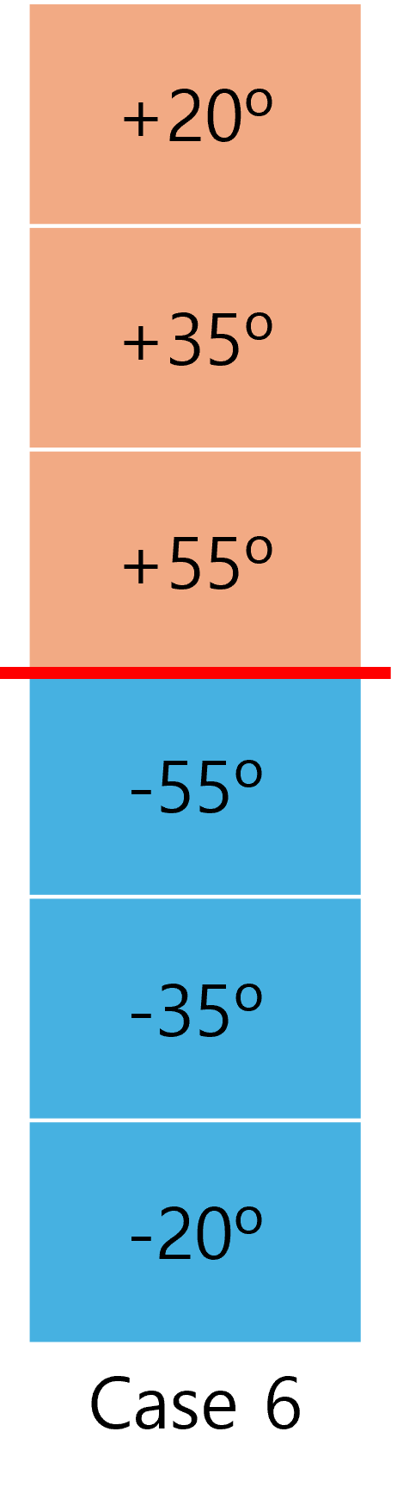
Key point from the TAC cases (6-ply)
Both use fewer plies to check advantage of TAC
Case 5
A11/A22 = 3.66
D11/D22 = 9.00
B16, B26 = -2.68, -0.78
Case 5 has the largest D11* among all cases, but it is highly directional because D22* is very low. Case 6 sacrifices some D11* but improves A22* and D22*, making it the more balanced 6-ply TAC representative
Case 6
A11/A22 = 1.99
D11/D22 = 6.16
B16, B26 = -2.83, -1.12
Conclusion: Case 6 is the preferred 6-ply TAC representative because it gives a better balance between x- and y-direction stiffness. Case 5 is best only if the design objective is maximum x-direction (D11*).

Slide 6
Result: Which case is best?
For aerospace structures, the preferred laminate is not simply the one with the largest D11*.
DD baseline vs 8-ply TAC
Case 1 is the best choice.
Case 4 is the best 8-ply TAC representative because A11*/A22* = 1.00.
However, Case 4 still has nonzero B16* and B26*, so the response is more coupled.
Case 3 has higher D11*, but it is too directionally biased for a general plate design.
DD baseline vs 6-ply TAC
Case 6 is stronger candidate if we are looking for weight reduction as primary goal.
Case 6 uses fewer plies and more balanced than Case 5.
Case 5 gives the largest D11*, but very low D22* makes it a specialized x-direction design.
For primary structure, Case 1 (DD) remains the safer baseline unless TAC coupling is fully validated.
Overall structure selection : Case 1 (DD)
It has B*=0, balanced in-plane stiffness, and a more predictable bending/buckling response.
Case 4 is the best 8-ply TAC alternative; Case 6 is the best 6-ply TAC alternative when weight saving is prioritized.

